Slide 1

Exam AZ-304: Microsoft Azure Architect Design Crash Course
Tim Warner

Slide 2


Tim Warner
Based in Nashville, TN, US
MCT, MVP
Twitter: @TechTrainerTim
Badge: timw.info

Slide 3
Course Materials
timw.info/az304

Slide 4
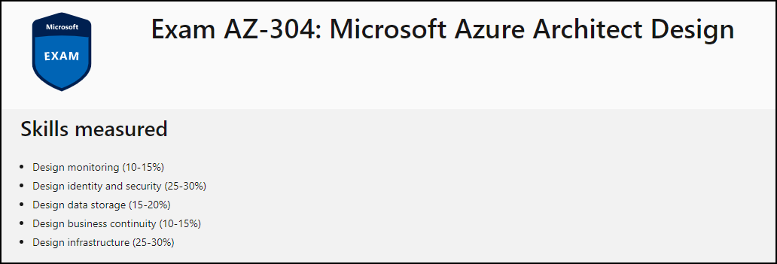
Learning Goals

Slide 5
Session 1
Design identity and security
Design data storage
Design monitoring

Slide 6
Session 2
Design business continuity
Design infrastructure
Azure Architect certification prep tips and tricks

Slide 7
Setting Expectations
Azure Architect is an expert-level certification
You should already know how to deploy and configure Azure resources
This is a "crash course"
Please plan to review these materials more than once
Recording takes ~24 hours to process
Five-minute break at midpoint
Please ask/answer questions and provide feedback in the Q/A panel, not the group chat

Slide 8

Course Recordings

Slide 9

Course Recordings

Slide 10
2020 Exam Update Information
Microsoft Worldwide Learning (WWL) revisits the Azure role-based certs yearly
Relevant blog post: timw.info/az2020
AZ-304 is available now
AZ-301 retires around September 30, 2020

Slide 11
Tim's Certification Study Pyramid
Interdependence
Content knowledge
Practical application
Test-taking skills

Slide 12
Migration and Disaster Recovery

Slide 13

Azure Backup

Slide 14

Azure Site Recovery

Slide 15
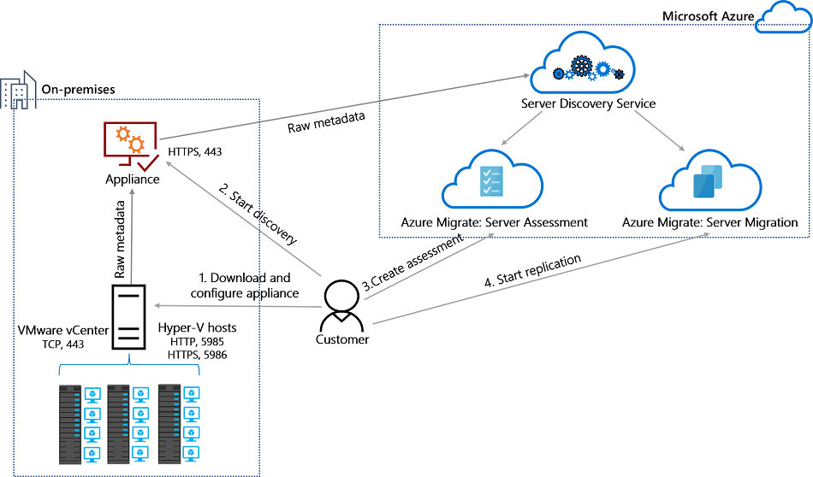
Azure Migrate

Slide 16
Azure Compute

Slide 17

VM Scale Sets

Slide 18
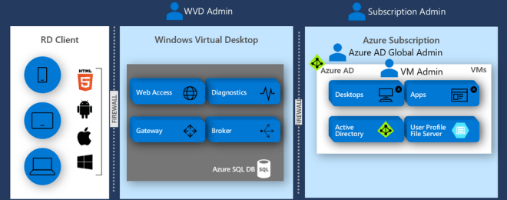
Windows Virtual Desktop (WVD)
timw.info/travis

Slide 19

Availability Set

Slide 20

Availability Zone

Slide 21
Load Balancing

Slide 22

VM Networking

Slide 23

Load Balancing

Slide 24

VNet Peering

Slide 25

Hybrid Networking

Slide 26

Network Virtual Appliance

Slide 27

Azure Load Balancer

Slide 28

Application Gateway

Slide 29

Traffic Manager

Slide 30

Front Door Service

Slide 31
Containers

Slide 32


Docker Container Lifecycle
https://timw.info/3635f

Slide 33
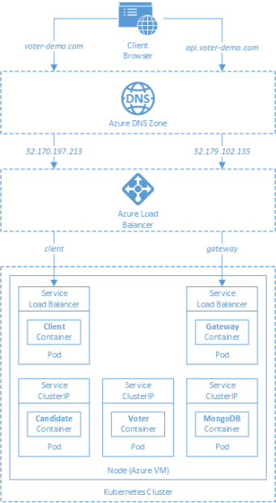
AKS

Slide 34
App Architecture

Slide 35

Event Architecture

Slide 36

Event Architecture

Slide 37
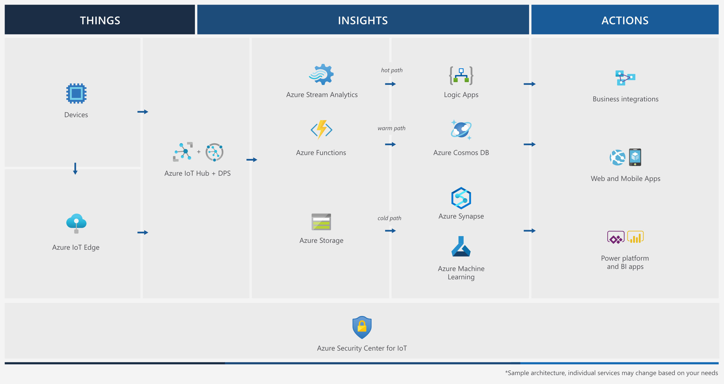
Event Architecture

Slide 38
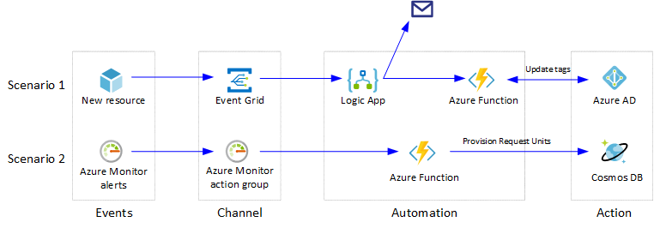
Event Architecture

Slide 39
Authentication

Slide 40

Tenant vs. Subscription

Slide 41

Hybrid Identity

Slide 42

Passthrough Authentication

Slide 43

Seamless Single Sign-on

Slide 44
Authorization and Governance

Slide 45

Azure Management Scopes
/ Tenant Root

Slide 46
Azure Storage

Slide 47
Storage Account Replication
1
3
3
2
LRS
ZRS

Slide 48
Storage Account Replication
3
3
GRS/RA-GRS

Slide 49
Storage Account Replication
1
3
1
3
2
2
GZRS – RA/GZRS

Slide 50

Always Encrypted

Slide 51

Data Pipelines

Slide 52
Monitoring

Slide 53

Azure Diagnostics

Slide 54

Log Analytics

Slide 55

Sentinel

Slide 56
Exam AZ-304 Item Types

Slide 57

Multiple Choice

Slide 58
Repeated Scenario
You need to move an Azure VM to another hardware host.
Solution: You redeploy the VM.
Does this solution meet the goal?
Yes
No

Slide 59

Select and Place

Slide 60

Build List and Reorder

Slide 61

Active Screen/Fill in the Blank

Slide 62

Case Study

Slide 63






Performance-Based Lab

Slide 64
Microsoft Online Testing

Slide 65
Microsoft Online Testing Process
timw.info/online

Slide 66

Microsoft Online Testing Process

Slide 67

Microsoft Online Testing Process

Slide 68

Microsoft Online Testing Process

Slide 69

Microsoft Online Testing Process

Slide 70

Microsoft Online Testing Process

Slide 71

Microsoft Online Testing Process

Slide 72

Microsoft Online Testing Process

Slide 73
AZ-304 Exam Strategy
Focus your skills accordingly:
60 percent Azure portal
20 percent Azure PowerShell
10 percent Azure CLI
10 percent KQL
Expect performance-based labs, but be thankful if you don't see 'em

Slide 74
Thank you!
Course materials: timw.info/az304
Twitter: @TechTrainerTim
Work: timw.info/ps
Web: TechTrainerTim.com

